Slide 1
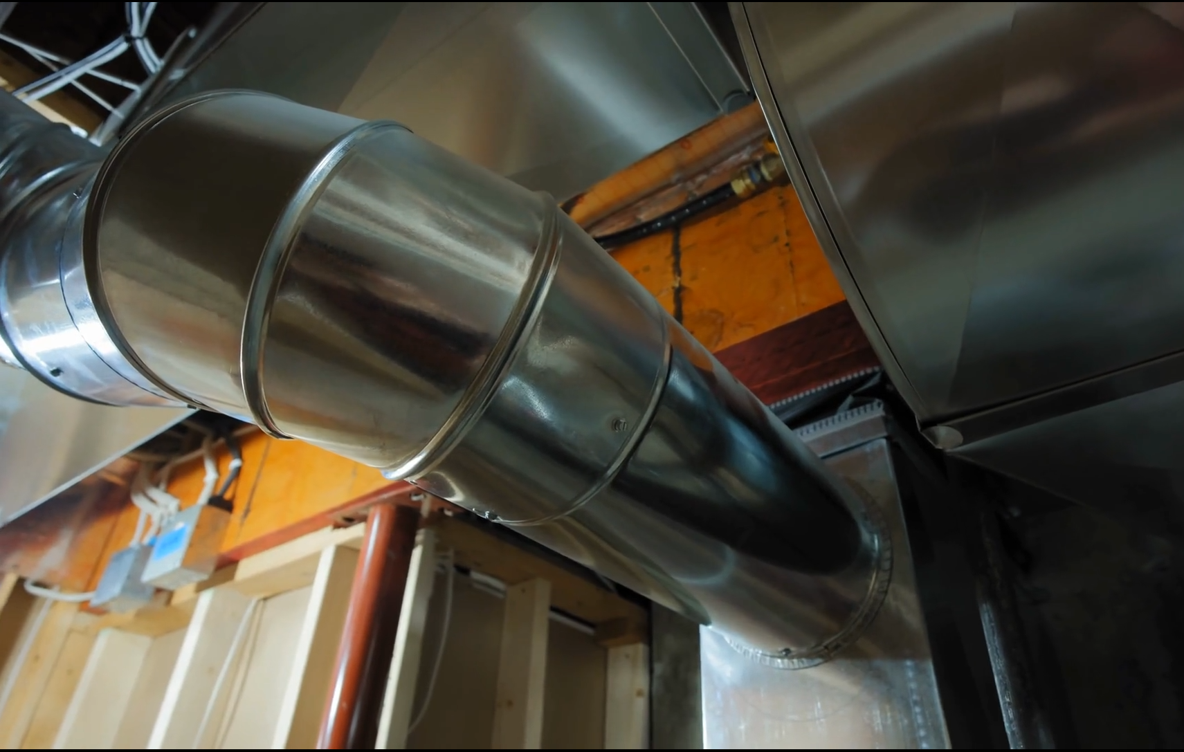
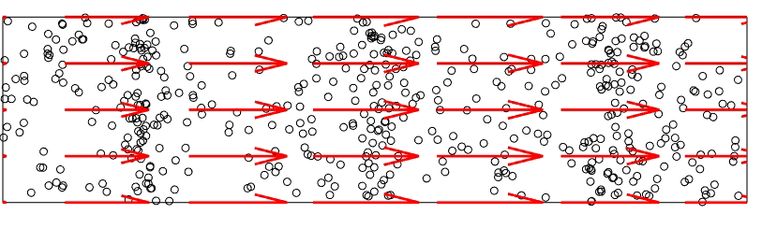
ACS 597: Noise Control Applications
Introduction
Tyler Dare

Slide 2

About Dr. Dare
B.S. from the University of Illinois
M.S. and Ph.D. from Purdue University
Dissertation: “Generation Mechanisms of Tire-Pavement Noise”
Board Certified, Institute of Noise Control Engineering of the USA

Slide 3


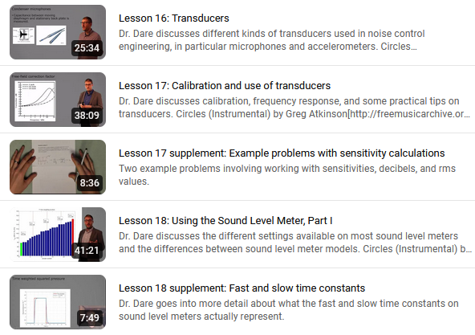
I wear many hats in the noise control community
Head of Engineering Acoustics Department at the Applied Research Laboratory (my “day job”)
Director of the Center for Acoustics and Vibration
Vice President for Congresses at International Institute for Noise Control Engineering
Lead instructor for INCE-USA’s Noise Control Engineering courses

Slide 4
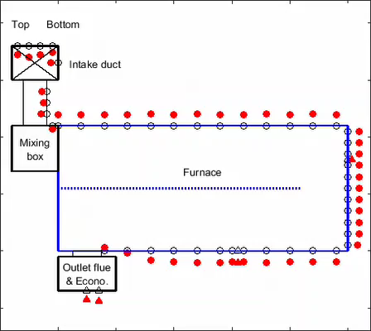
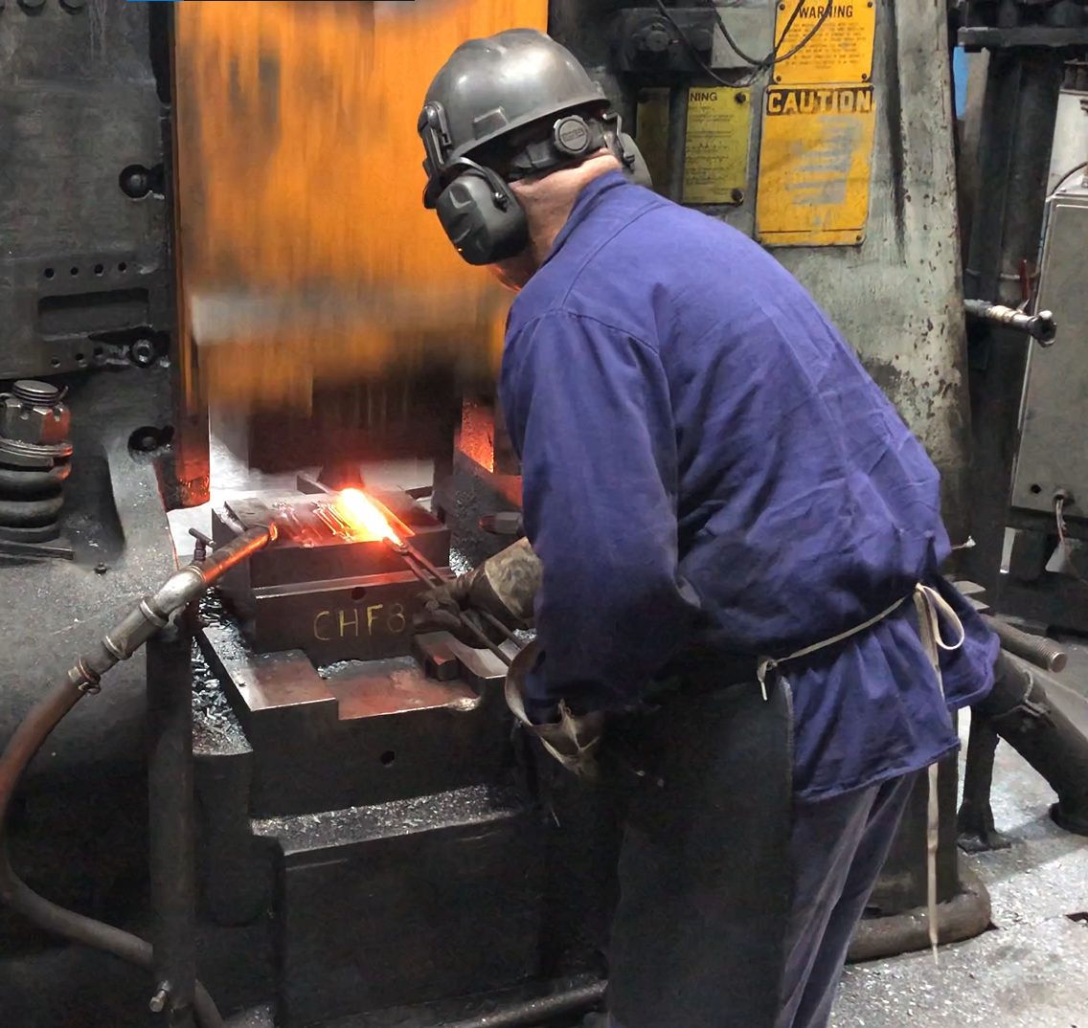
Research
Research mission: to have fun solving interesting problems with great people

Slide 5
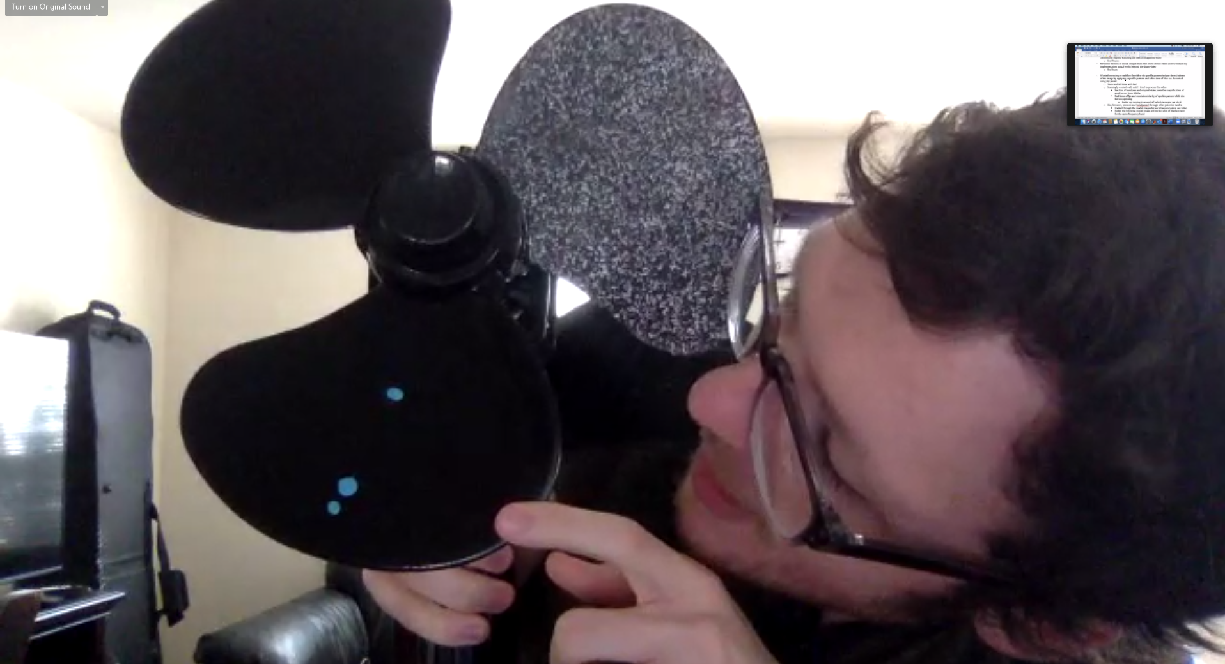
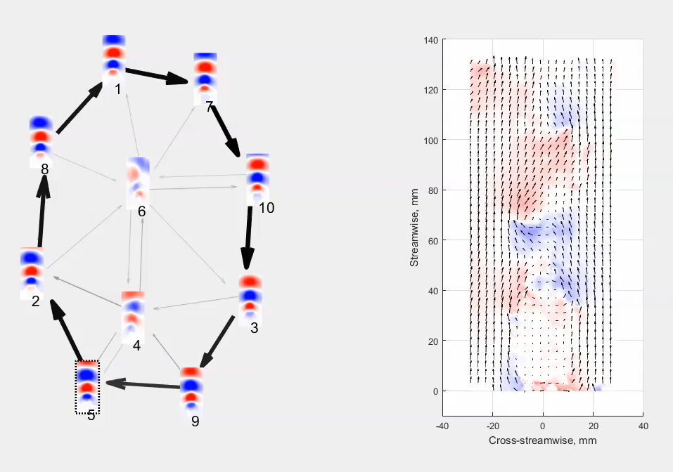
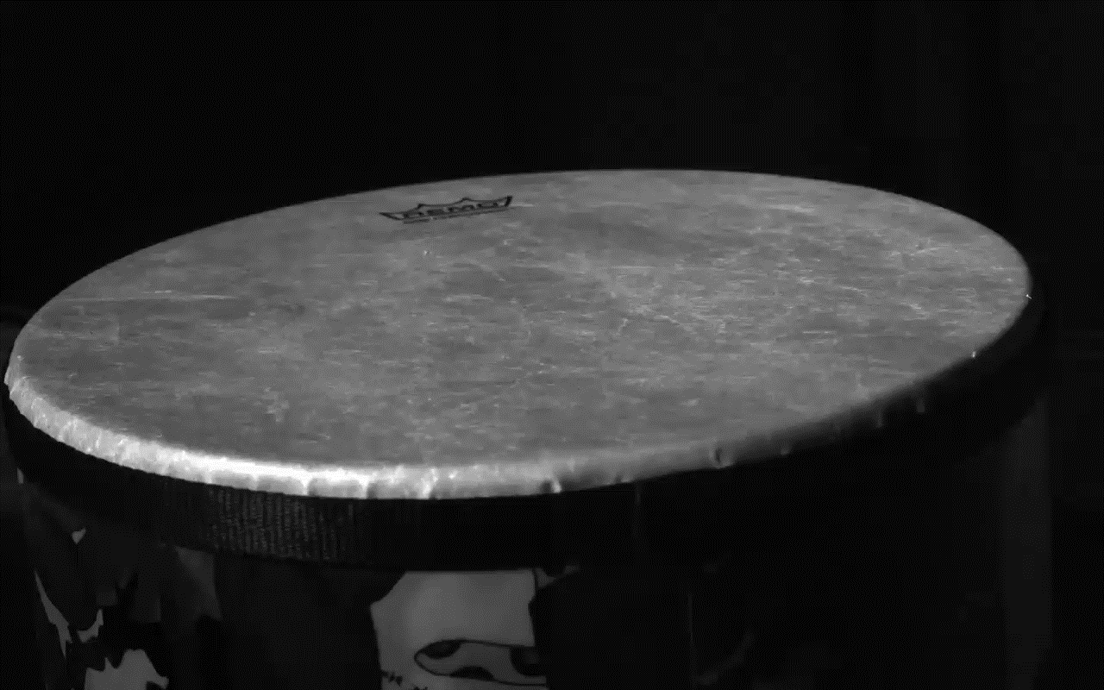
Research
Research mission: to have fun solving interesting problems with great people

Slide 6
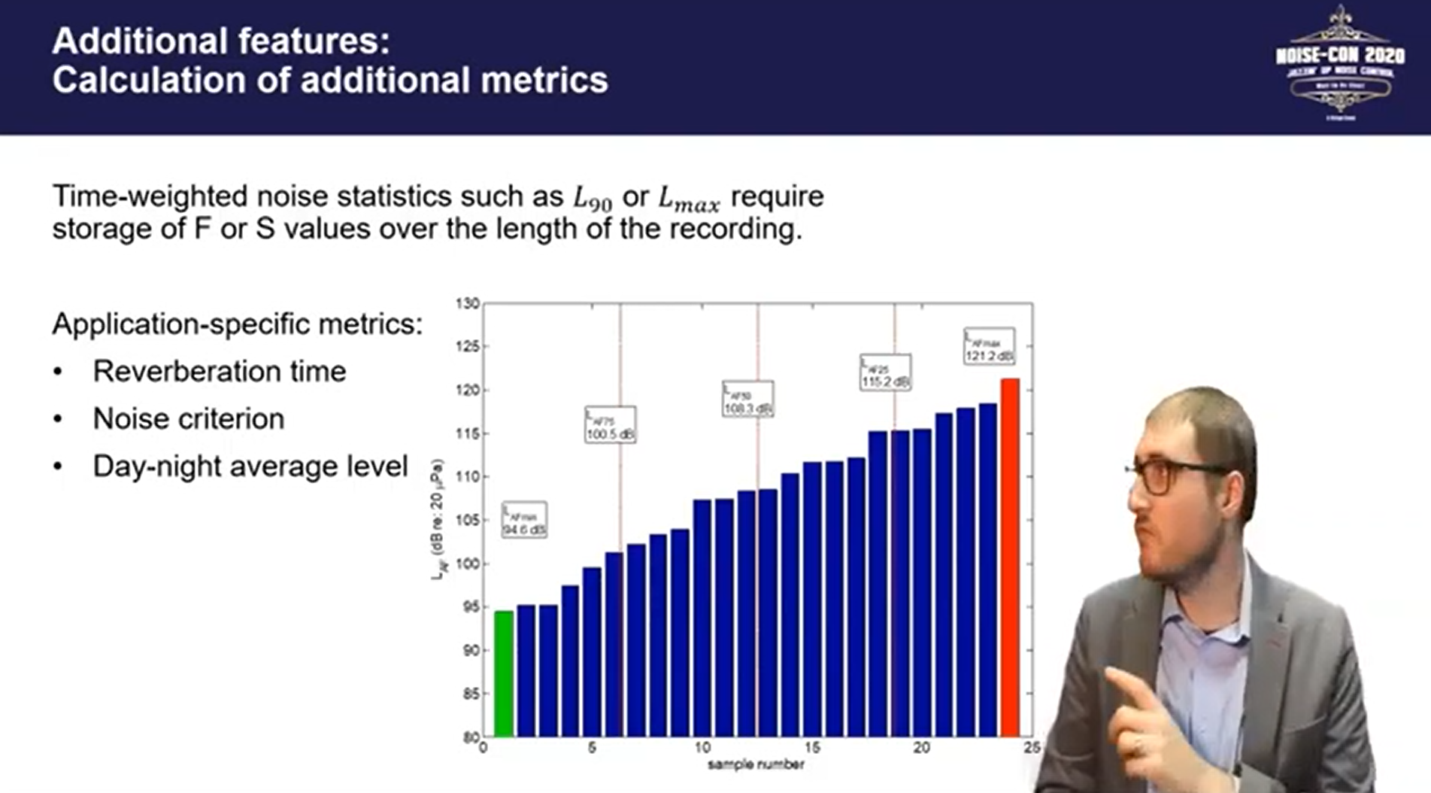
Teaching
Teaching mission: to help people learn hard things with humor and empathy
Courses taught:
ACS 505, Experimental Techniques in Acoustics (10 times)
ACS 503, Signal Analysis (last semester)
AERSP 305, Experimental Methods in Aerospace (8 times)
INCE-USA Noise Control Engineering (since 2019)
Short courses
Machine learning in acoustics
Acoustic signal analysis

Slide 7
Other people to know
Kris Popovich—Distance Education support
Paula Sedlacek—Producer
Andrew Barnard—Previous instructor of this course
Resident students
Carter Paprocki
Colin Flavin

Slide 8
Tell me about yourself (survey on Canvas, due tomorrow)
What other acoustics-related classes have you taken, at Penn State or elsewhere?
What does a typical work day or week for you look like?
What are you most hoping to learn about? For example, is there a noise control topic do you wish you had a deeper understanding of?
Is there any topic that you think you should know, but maybe could use a refresher on?
Is there anything else you would like me to know about you?

Slide 9
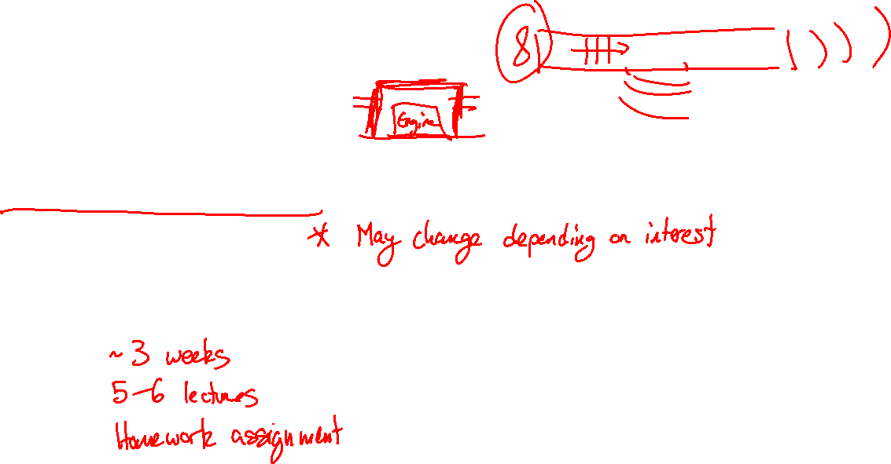
Class is broken into modules
Ducts, mufflers, and silencers
Acoustic enclosures
Vibration control
Acoustic sources
Rotating machinery
Each module contains:

Slide 10
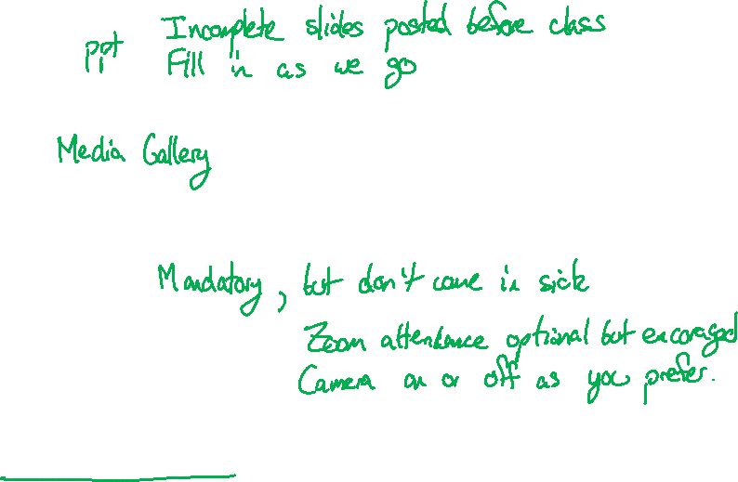
Class format
Lecture notes
Recordings
Attendance
Resident students:
Distance education students:
Office hours
Fridays, 1–2 pm via Zoom. See Canvas calendar for link.
Or by appointment, including evenings or weekends

Slide 11
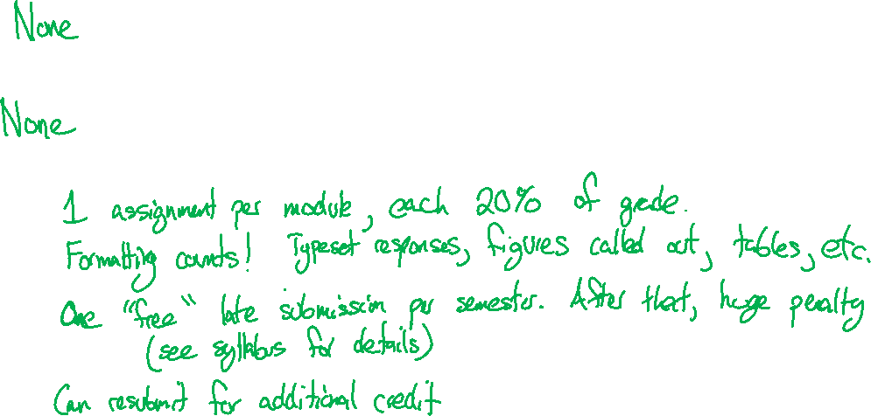
Homework, exams, and grading
Exams—
Final—
Homework—

Slide 12
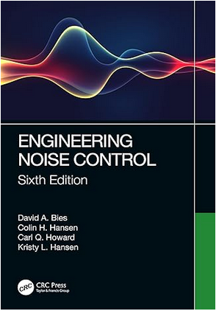
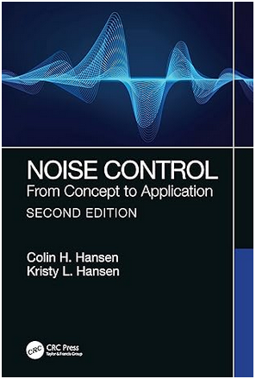
Other course requirements
MATLAB or other programming language
Nothing extremely advanced, but matrix multiplication gets yucky in Excel.
See resources on Canvas if you want to learn
Book is not required
See links on Canvas
See errata on authors’ website (also it’s a very 1990s style website, which is fun)
$60
$66

Slide 13
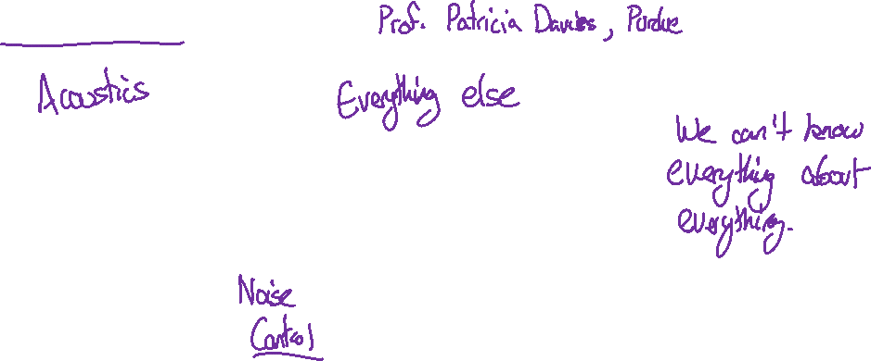
“Noise Control is Constrained Acoustics”

Slide 14
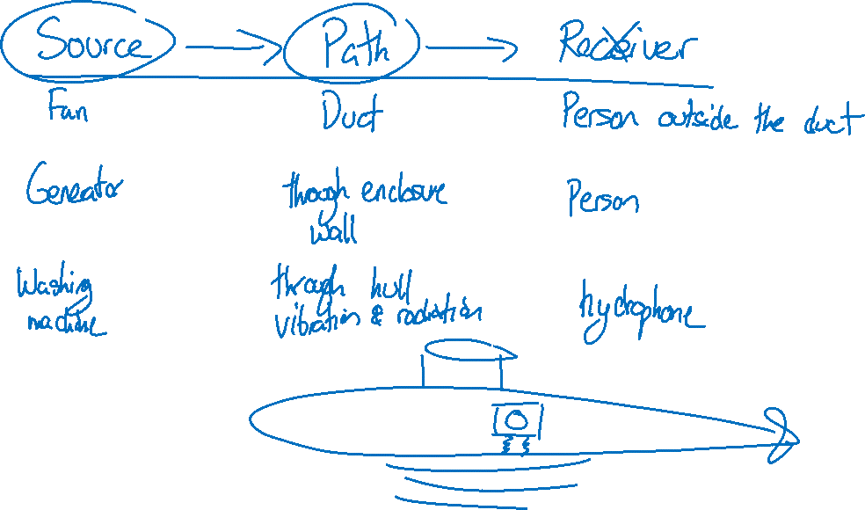
Source-path-receiver model

